Slide 1
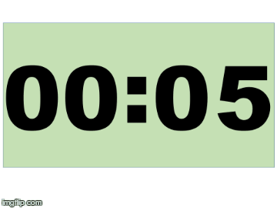
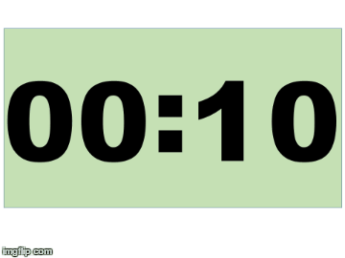
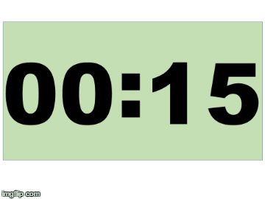
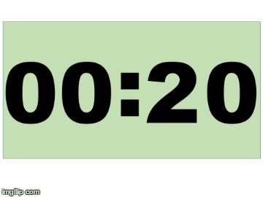
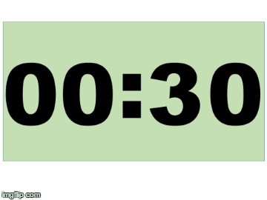
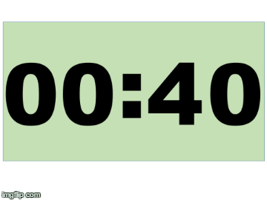
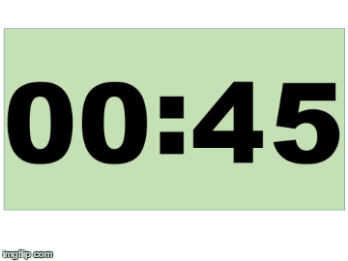
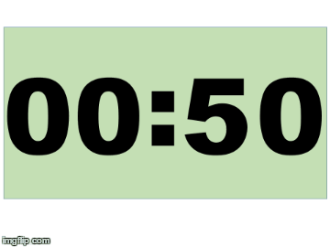
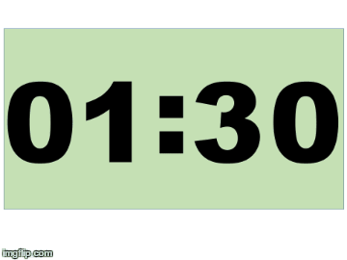
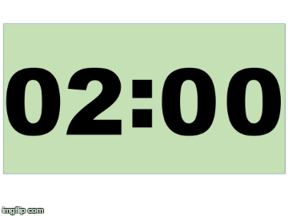
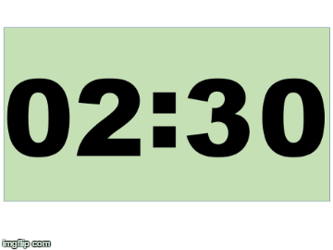
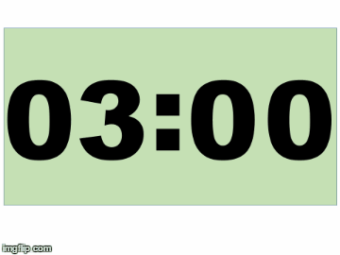
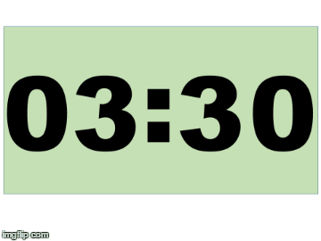
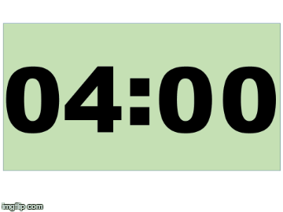
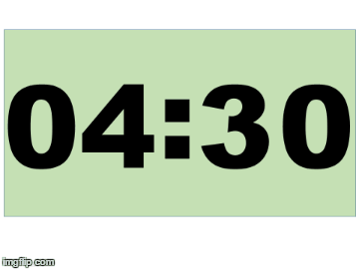
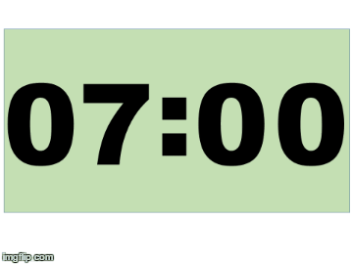
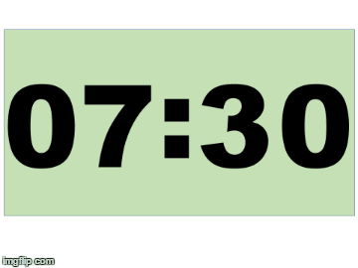
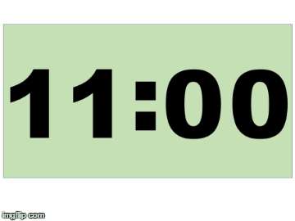
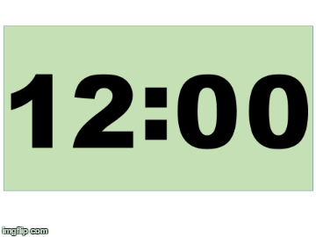
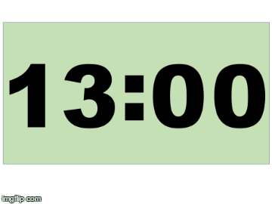

Slide 2
Securing Knowledge (KS2) | Developing Knowledge (KS3) | Extending Knowledge (KS4)
Compare and group materials together, according to whether they are solids, liquids or gases Observe that some materials change state when they are heated or cooled, and Measure or research the temperature at which this happens in degrees Celsius (°C) Identify the part played by evaporation and condensation in the water cycle and associate the rate of evaporation with temperature. | Comparing the starting with the final conditions of a system and describing increases and decreases in the amounts of energy associated with temperatures. Changes with temperature in motion and spacing of particles Internal energy stored in materials. | Relating models of arrangements and motions of the molecules in solid, liquid and gas phases to their densities Melting, evaporation, and sublimation as reversible changes Calculating energy changes involved on heating, using specific heat capacity; and those involved in changes of state, using specific latent heat Links between pressure and temperature of a gas at constant volume, related to the motion of its particles (qualitative)

Slide 3
Heat, Temperature and Thermal Energy | 28 October 2022
State the name of the diagram used to show efficiency of energy transfers.
A kettle has an input of 200 J of energy and 50 J is transferred to the thermal store of the water. Calculate how much energy is wasted.
Calculate the efficiency of the kettle.
What is the appropriate instrument to use to measure temperature?
State the temperature reading on the thermometer to the right.
Sankey diagram
150 J
0.25 or 25%
Thermometer
21 ∘C

Slide 4
Learning Journey
Energy Stores and Transfers
Prior | Energy Stores
Building | Heating
 | 1. Heat and Temperature
 | 2. Changes of State
 | 3. Practically Investigating Density
 | 4. Energy Transfers by Conduction
 | 5. Energy Transfers by Convection
 | 6. Energy Transfers by Radiation
 | 7. Practically Investigating Infrared Radiation
 | 8. Insulators in the Home
 | 9. Practically Investigate Insulators
 | 10. Practically Investigate Specific Heat Capacity
Future | Molecules and Matter

Slide 5
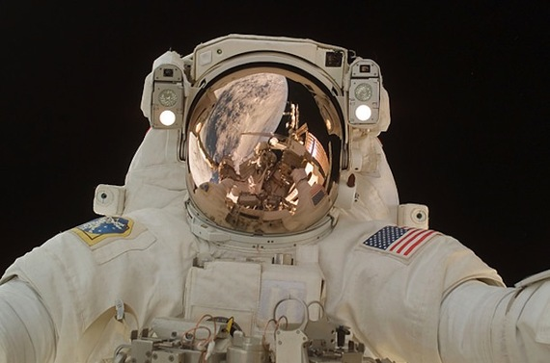
Heat and Temperature
BUILDING CURIOSITY Which is hotter a swimming pool or a cup of tea?
 | Cultural Capital |  | Key concepts |  | Powerful Language
Astronauts deal with extreme temperatures. Engineers have to design their suits to withstand extreme temperatures. |  | State the units of heat and temperature. Explain the meaning of the terms heat, thermal energy and temperature. |  | Heat Temperature Thermal Store
Notes:
Over to you….
Paired work to create a learning goal slide for a lesson that will be taught in the first two weeks of term.

Slide 6
Memory Dump

Slide 7
Think
Pair
Share

Slide 8
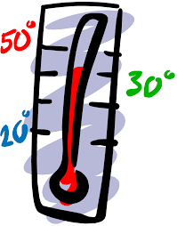
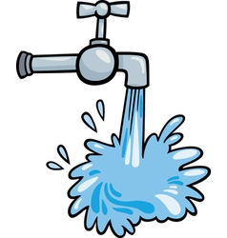
 | Memory Dump all keywords related to the pictures
 | Compare any similarities and differences with the pictures
 | Suggest how you could link, group or order these pictures together.

Slide 9
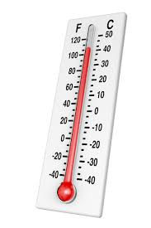
Match the temperature:
Bulb filament
37ºC
Body Temperature
100ºC
Room Temperature
20ºC
Boiling point of water
0ºC
Inside a freezer
2800ºC
Freezing point of water
-20ºC
Extension: Come up with your own definition of what temperature is

Slide 10
Match the temperature:
Bulb filament
2800ºC
Body Temperature
37ºC
Room Temperature
20ºC
Boiling point of water
100ºC
Inside a freezer
-20ºC
Freezing point of water
0ºC
Extension: Come up with your own definition of what temperature is

Slide 11
Magic Four
Normal | Challenging
State as many keywords as you can from the video. | Create a question with answer about the video.
Describe in your own words what one of the keywords means. | Explain the key points from the video.

Slide 12
Normal | Challenging
State as many keywords as you can from the video. | Create a question with answer about the video.
Describe in your own words what one of the keywords means. | Explain the key points from the video.

Slide 13
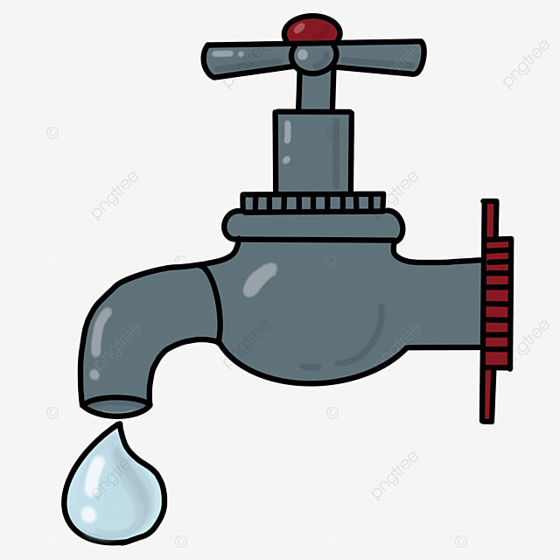
 | Thermal Energy | Temperature
Definition | The total energy of all the particles moving inside an object | How hot or cold an object is – the average energy of its particles
Measured in | J | ºC
Lots | A hot bath | A spark
Little | A drip from a tap | A snowflake

Slide 14
Think
Pair
Share

Slide 15
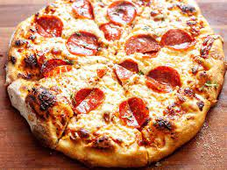
Thermal Energy (Heat) vs Temperature
Arrange these objects into two lists: one list in order of temperature (hottest first), the other in order of thermal energy (most first): a lit match; an ice cube; a hot pizza; a horse.
Explain why you’ve put each list in the order you have…
Hottest
Match
Pizza
Horse
Ice cube
Coldest
Most thermal energy
Horse
Pizza
Ice cube
Match
Least thermal energy

Slide 16
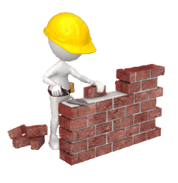
Vocabulary Builder

Slide 17
Heat and Temperature: Vocabulary builder
1 | Match the key term to the correct definition. |  | [3 marks]
Keyword |  | Definition
Heat |  | The average kinetic energy of the particles in an object.
Temperature |  | The amount of thermal energy stored in a object.
Thermometer |  | Used to measure the temperature of an object.
2 | Choose the correct keyword to complete these sentences |  |  | [3 marks]
a | Heat is measured in | J | ºC | W
b | Temperature is measured in | J | ºC | W
c | Energy transferred per second is measured in | J | ºC | W
3 | Choose the correct words to complete the following sentences. |  |  |  | [5 marks]
1. Amount |  | 2. Hotter | 3. Mass | 4. Substance | 5. Transferred
When heat energy is ___________ to an object, its temperature increase depends upon the: ___________ of the object, ___________ the object is made from and ___________ of energy transferred to the object. If there is a difference in temperature between two objects, energy transfers by heating from the ___________ object to the cooler one.
Notes:
Print off vocabulary and knowledge builder for students to complete. Students should complete the vocabulary builder first then move on to the knowledge builder.

Slide 18
Knowledge Builder

Slide 19
Heat and Temperature: Knowledge builder
Energy can transfer by heating from a hotter region to a cooler region. The temperature of the hotter region decreases. The temperature of the cooler region increases. Heating can occur by conduction, radiation or convection.
The hotter an object, the more energy it has in its thermal energy store. The average speed of particles in a hot substance is greater than a cold. Temperature depends on the average speed of the particles in a substance.
Hot tea has more energy in its thermal energy store than cold tea. As the tea cooled, the average speed of the particles in the tea reduced. Energy has transferred from the thermal energy store of the tea to the thermal energy store of the surroundings.
1 | State the three ways in which energy can be transferred.
2 | Explain the properties of a cup of tea.
3 | Create questions of your own using the information above.

Slide 20
Improvement Time

Slide 21
Heat and Temperature: Vocabulary builder
1 | Match the key term to the correct definition. |  | [3 marks]
Keyword |  | Definition
Heat |  | The average kinetic energy of the particles in an object.
Temperature |  | The amount of thermal energy stored in a object.
Thermometer |  | Used to measure the temperature of an object.
2 | Choose the correct keyword to complete these sentences |  |  | [3 marks]
a | Heat is measured in | J | ºC | W
b | Temperature is measured in | J | ºC | W
c | Energy transferred per second is measured in | J | ºC | W
3 | Choose the correct words to complete the following sentences. |  |  |  | [5 marks]
1. Amount |  | 2. Hotter | 3. Mass | 4. Substance | 5. Transferred
When heat energy is transferred to an object, its temperature increase depends upon the: mass of the object, substance the object is made from and amount of energy transferred to the object. If there is a difference in temperature between two objects, energy transfers by heating from the hotter object to the cooler one.

Slide 22
Energy can transfer by heating from a hotter region to a cooler region. The temperature of the hotter region decreases. The temperature of the cooler region increases. Heating can occur by conduction, radiation or convection.
The hotter an object, the more energy it has in its thermal energy store. The average speed of particles in a hot substance is greater than a cold. Temperature depends on the average speed of the particles in a substance.
Hot tea has more energy in its thermal energy store than cold tea. As the tea cooled, the average speed of the particles in the tea reduced. Energy has transferred from the thermal energy store of the tea to the thermal energy store of the surroundings.
1 | State the three ways in which energy can be transferred.
2 | Explain the properties of a hot cup of tea.

Slide 23
Hinge Point Question

Slide 24
Think
Pair
Share

Slide 25
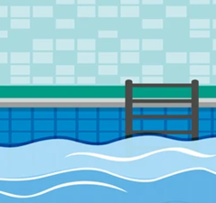
A teacher asks the class to explain which would be better to raise the temperature of a swimming pool a bucket of water or a cup of tea? Choose the best answer and suggest any improvements.
a | A cup of tea because it has the highest temperature.
b | The bucket of water because it has the highest mass
c | The cup of tea because it has the highest store of energy.
d | The bucket of water because it has the highest store of energy.

Slide 26
Improvement Time

Slide 27
A teacher asks the class to explain which would be better to raise the temperature of a swimming pool. A bucket of water with a cup of tea? Choose the best answer and suggest any improvements.
a | A cup of tea because it has the highest temperature.
b | The bucket of water because it has the highest mass
c | The cup of tea because it has the highest store of energy.
d | The bucket of water because it has the highest store of thermal energy so will transfer the most energy to the swimming pool.

Slide 28
Quick 8 Question Quiz

Slide 29
 |  | A | B | C | D
1 | State what is used to measure temperature. | Measuring Cylinder | Ruler | Light Gate | Thermometer

Slide 30
 |  | A | B | C | D
1 | State what is used to measure temperature. | Measuring Cylinder | Ruler | Light Gate | Thermometer
2 | State the unit for heat. | W | J | ºC | kg

Slide 31
 |  | A | B | C | D
1 | State what is used to measure temperature. | Measuring Cylinder | Ruler | Light Gate | Thermometer
2 | State the unit for heat. | W | J | ºC | kg
3 | State the unit for temperature. | W | J | ºC | kg

Slide 32
 |  | A | B | C | D
1 | State what is used to measure temperature. | Measuring Cylinder | Ruler | Light Gate | Thermometer
2 | State the unit for heat. | W | J | ºC | kg
3 | State the unit for temperature. | W | J | ºC | kg
4 | State the unit for power. | W | J | ºC | kg

Slide 33
 |  | A | B | C | D
1 | State what is used to measure temperature. | Measuring Cylinder | Ruler | Light Gate | Thermometer
2 | State the unit for heat. | W | J | ºC | kg
3 | State the unit for temperature. | W | J | ºC | kg
4 | State the unit for power. | W | J | ºC | kg
5 | State the unit for mass. | W | J | ºC | kg

Slide 34
 |  | A | B | C | D
1 | State what is used to measure temperature. | Measuring Cylinder | Ruler | Light Gate | Thermometer
2 | State the unit for heat. | W | J | ºC | kg
3 | State the unit for temperature. | W | J | ºC | kg
4 | State the unit for power. | W | J | ºC | kg
5 | State the unit for mass. | W | J | ºC | kg
6 | State the object with the largest store of thermal energy. | Hot cup of tea | The ocean | Swimming pool | Bunsen burner flame

Slide 35
 |  | A | B | C | D
1 | State what is used to measure temperature. | Measuring Cylinder | Ruler | Light Gate | Thermometer
2 | State the unit for heat. | W | J | ºC | kg
3 | State the unit for temperature. | W | J | ºC | kg
4 | State the unit for power. | W | J | ºC | kg
5 | State the unit for mass. | W | J | ºC | kg
6 | State the object with the largest store of thermal energy. | Hot cup of tea | The ocean | Swimming pool | Bunsen burner flame
7 | Choose the object with the highest temperature. | Hot cup of tea | The ocean | Swimming pool | Bunsen burner flame

Slide 36
 |  | A | B | C | D
1 | State what is used to measure temperature. | Measuring Cylinder | Ruler | Light Gate | Thermometer
2 | State the unit for heat. | W | J | ºC | kg
3 | State the unit for temperature. | W | J | ºC | kg
4 | State the unit for power. | W | J | ºC | kg
5 | State the unit for mass. | W | J | ºC | kg
6 | State the object with the largest store of thermal energy. | Hot cup of tea | The ocean | Swimming pool | Bunsen burner flame
7 | Choose the object with the highest temperature. | Hot cup of tea | The ocean | Swimming pool | Bunsen burner flame
8 | The higher the temperature the higher the ……… of the particles. | Mass | Kinetic Energy | Power | Size

Slide 37
Improvement Time

Slide 38
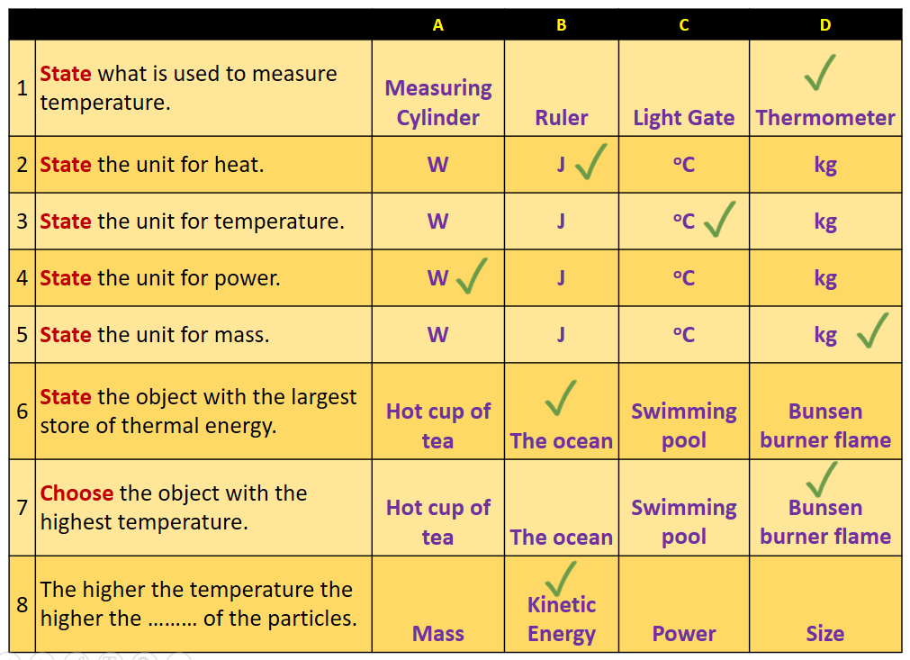
Next Steps | Choose 3 questions and re-write them as facts that you need to make stick
 | Create 3 questions with answers about this topic to ask to your partner

Slide 39
Deeper Thinking

Slide 40
Explain why a swimming pool has a greater thermal energy store than a cup of tea. (4 marks)
Explain: to use scientific understanding to make something clear or state the reason for something happening
To ‘explain’ your answer should:
Begin with a scientific statement.
Use ‘this means that’, ‘because’ or ‘so’ to link your statement to the question.
Temperature is related to the average kinetic energy of the particles in a substance.
Thermal energy is a measure of the total energy that all the particles in a substance have.
So the swimming pool has more particles with some kinetic energy, which means it has greater thermal energy store than a hot cup of tea with fewer particles which have lots of kinetic energy.
Notes:
This slide models the process of answering an explain question.
The generic question and answer should be used by the teacher to remind students of
the key features of a great answer
how to structure their answer
why the model answer is a good example
Following this, students will be required to apply this process to answer their own explain question, which will appear in place of the generic questions. This explain question will be specific to the topic students are learning about in the lesson. Give students time to write their own answer to this, ensuring that they use the guidance provided. To further scaffold this task for students, it may be appropriate to:
pair students up to write an answer together
list for students the key words you would like them to include in the answer
provide a writing frame or ‘points to include’ for students

Slide 41
Explain why a warm bath has a greater thermal energy store than a sparkler. (5 marks)
Stretch and Challenge | Suggest why a spark from a sparkler does not burn you when it touches your hand
Notes:
it may be appropriate to:
pair students up to write an answer together
list for students the key words you would like them to include in the answer
provide a writing frame or ‘points to include’ for students

Slide 42
Improvement Time

Slide 43
Temperature is related to the average kinetic energy of the particles in a substance. Thermal energy is a measure of the total energy that all the particles in a substance have. So the bath has more particles with some kinetic energy. The tea has fewer particles which have lots of kinetic energy. Which means the bath has a bigger thermal energy store than the tea.
Next Steps | Include the following keyword/key term in your answer …. Include the following explanation in your answer …. Attempt the stretch and challenge question. Link ideas to electrolysis.
S + C | The spark has a high temperature but low thermal store. So when the spark hits you there is not enough energy to transfer to you to burn your hand.

Slide 44
Exit Ticket

Slide 45
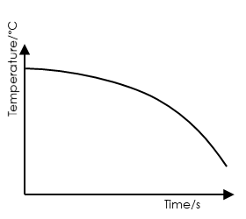
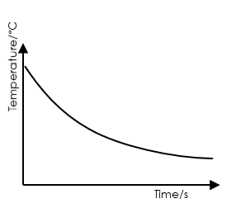
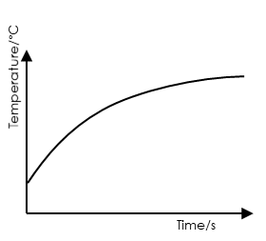
 |  | A | B | C
1 | Identify the store below which has the most thermal energy | Hot water | Ice Berg | Warm Sunlight
2 | State the unit for heat. | W | J | ºC
3 | Choose the graph most closely matches the curve that would be found for a hot dog at a cricket match?
Notes:
Q1. Answer: B.
If students answer A, it suggests that they are confusing temperature with thermal energy. To fix-it, reteach the definitions of these with some examples, and ask student to identify some more examples of objects with a great and a little amount of thermal energy. If students answer C, it suggests that students are confusing an energy store with an energy carrier (radiation). To fix-it, ask students to identify the energy store and carrier(s) in a number of different scenarios.
Q2. Answer: C.
If students answer A, they are mixing up the unit of thermal energy with that of temperature, and may be confused about the difference between these. If the student answers B, they are confusing the unit of heat with temperature. To fix-it, reteach the definitions of the terms heat, temperature and thermal energy. Ask students to identify whether a selection of scenarios have a lot or a little thermal energy, heat or a high/low temperature.
Q3. Answer: B.
This is quite a challenging question, effectively combining the previous two ideas into a graphical representation of the same thing. If students identify graph A for either answer, ensure they realise why the graph must be steeper at the start – the change of temperature (heating or cooling) happens quickest at the beginning because the temperature difference is bigger at the beginning. If they associate the burger with C, check they understand that the burger is going to cool down, not heat up. To fix-it, give students a selection of scenarios to match with an appropriate cooling or heating curve. E.g. an ice lolly at the beach would look like graph C.

