Slide 1
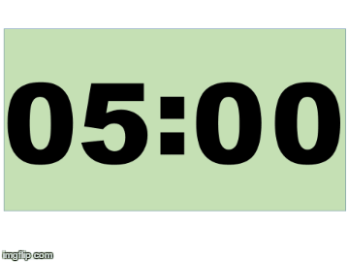
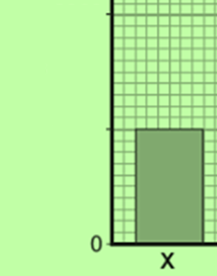
Todays Title: Density Required Practical
Date: 27 November 2022
Suggest why burning coal is the most environmentally damaging out of the three fossil fuels. |  |  |  | 3
Explain what parallax error is. |  | Convert 41,862 to 1 significant figure |  | 2
State the resolution of the piece of equipment is below. | State the piece of equipment shown left and what it is used to measure. |  | State the values of the three different boxes. | 1
50
Energy (J)
50
25
0

Slide 2
Improvement Time

Slide 3
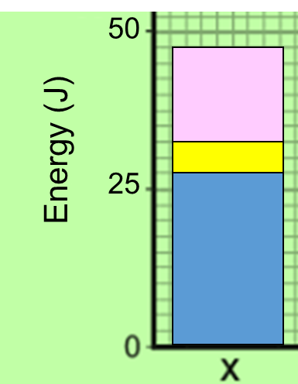
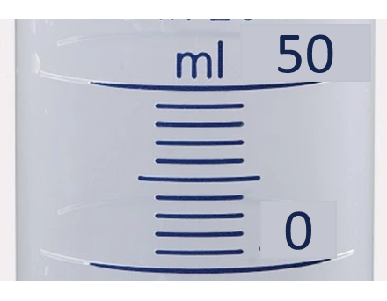
Burning coal produces carbon dioxide and sulphur dioxide Burning other fossil fuels only produces carbon dioxide. Sulphur dioxide leads to acid rain which damages the environment
Parallax error is caused by a student not reading the measurement at eye level. It can lead to the reading being too high or too low. |  | 41,862 is 40,000 to 1 significant figures
The resolution of the piece of equipment is below 5 ml. As this is the smallest measurement which can be recorded. | The piece of equipment shown left is a measuring cylinder and is used to measure volume of a liquid. |  | Pink = 47.5 J Yellow = 32.5 J Blue 27.5 J

Slide 4
What are we LEARNING?
BIG QUESTION? Why do objects float
 | Links |  | Key concepts |  | Powerful language
States of matter (Y7). |  | How to find the density of an object experimentally |  | Density Mass Volume
Notes:
Over to you….
Paired work to create a learning goal slide for a lesson that will be taught in the first two weeks of term.

Slide 5
Falsies
Correct each sentence to make it true
Weight is how much matter an object has
Volume of a cube is the square of the length
Density = volume / mass
Aristotle’s Principle is that the volume of an object = the volume of water it displaces
Notes:
5m plenary – correct sentences

Slide 6
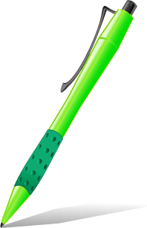
Falsies
Correct each sentence to make it true
Mass is how much matter an object has
Volume of a cube is the cube of the length
Density = mass / volume
Archimedes’ Principle is that the volume of an object = the volume of water it displaces

Slide 7
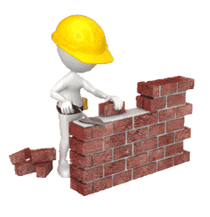
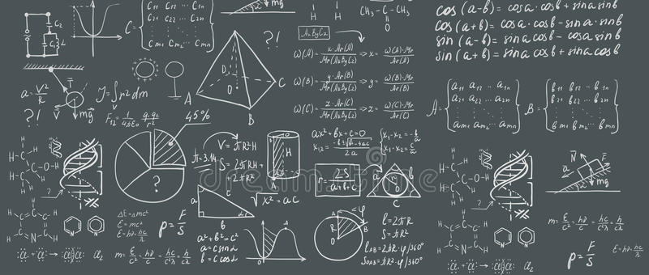
Equation Builder

Slide 8
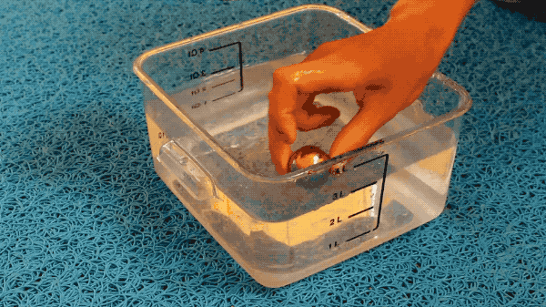
WORDS | Density
UNITS | Kg/m³

Slide 9
WORDS | Density | = | Mass
UNITS | Kg/m³ |  | kg

Slide 10
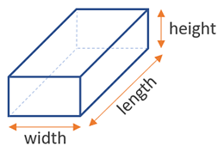
WORDS | Density | = | Mass | ÷ | Volume
UNITS | Kg/m³ |  | kg |  | m³

Slide 11
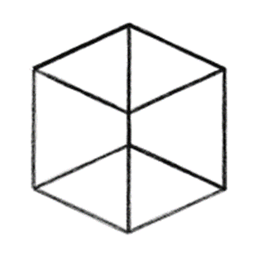
Calculate the density of a cube that has a mass of 9.1g
2cm
2cm
2cm

Slide 12
Calculate the density of a cube that has a mass of 9.1g
2cm
2cm
2cm

Slide 13
Calculate the density of a cube that has a mass of 9.1g
2cm
2cm
2cm

Slide 14
Calculate the density of a cube that has a mass of 9.1g
2cm
2cm
2cm

Slide 15
Calculate the density of a cube that has a mass of 9.1g
2cm
2cm
2cm

Slide 16
Calculate the density of a cube that has a mass of 9.1g
2cm
2cm
2cm

Slide 17
Challenge: Calculate the density of each material.
$$Density(g/{cm}^{3})= \frac{Mass (g)}{Volume ({cm}^{3})}$$
1g/cm³ = 1000kg/m³
Notes:
5m – a cube, rulers, calcs on each table

Slide 18
Challenge: Calculate the density of each material.
$$Density(g/{cm}^{3})= \frac{Mass (g)}{Volume ({cm}^{3})}$$
1g/cm³ = 1000kg/m³
Notes:
2m – go through the answers, check understanding

Slide 19
Magic Four
Challenge!!! How many of the questions can you answer about the video
State the equipment needed to carry out todays practical. | Suggest a control variable for this experiment.
State the what equipment is used to take measurements and what they measure | Suggest a hazard for this experiment.

Slide 20
State the equipment needed to carry out todays practical. | Suggest a control variable for this experiment.
State the what equipment is used to take measurements and what they measure | Suggest a hazard for this experiment.

Slide 21
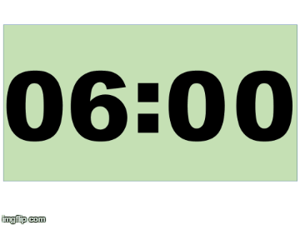
Worksheet

Slide 22
Improvement Time

Slide 23
Measuring Cylinder | Used to measure the mass of the irregular shape.
Top-Pan Balance | Used to measure the volume of liquid displaced.
Displacement | When water is moved from one place to another
Calculate the volume using the equation Density = Mass / Volume | 1 | 2 | 3 | 4
Record the mass of the irregular shape. | 1 | 2 | 3 | 4
Record the volume of water displaced. | 1 | 2 | 3 | 4
Place the irregular shape into the displacement can. | 1 | 2 | 3 | 4
The main control for this experiment is ensuring the water is level with the water spout. The main hazard for this experiment is water spillage. To reduce any risks make sure that any spilt water is mopped up immediately.
WORDS | Density | = | Mass | ÷ | Volume
UNITS | Kg/m³ |  | kg |  | m³
C | Mass = 40 g Volume = 10 m³
E | Density = Mass ÷ Volume
M | Density = 40 ÷ 10
U | 4 g / cm³
The unit for Density is | Kg/m³
The unit for Mass is | kg
The unit for Volume is | m³

Slide 24
Physics: Required Practical $ρ=\frac{m}{V}$
Explain a method for calculating the density of a irregularly shaped object. (6 marks)

Slide 25
To succeed in this practical…
In groups of 2/3, calculate the density of plasticine
Give the answer in g/cm³ and kg/m³
Write all steps and working out you do in your books
After 10m, each group will hold up their density value
Notes:
1m – whiteboards, green pens

Slide 26
To succeed in this practical…
In groups of 2/3, calculate the density of plasticine
Give the answer in g/cm³ and kg/m³
Write all steps and working out you do in your books
After 10m, each group will hold up their density value
If you finish:
What did you use as the volume to work out the density of the plasticine?
What is Archimedes’ Principle?
Could we use another liquid other than water for this experiment to work?
Imagine we have magic plasticine whose density is less than the density of water. Could we still use Archimedes’ Principle?
Notes:
10m practical
5m discussion

Slide 27
Physics: Required Practical $ρ=\frac{m}{V}$
Explain a method for calculating the density of a regular shaped object. (3 marks)

Slide 28
Physics: Required Practical $ρ=\frac{m}{V}$
Explain a method for calculating the density of a regular shaped object. (3 marks)

Slide 29
E | QUATION

Slide 30
Explain a method for calculating the density of a irregularly shaped object. (6 marks)
E | Equation used to calculate the density an object. density = mass/volume

Slide 31
E | QUATION
R | ECORD

Slide 32
Explain a method for calculating the density of a irregularly shaped object. (6 marks)
E | Equation used to calculate the density an object. density = mass/volume
R | Record the mass of the irregular shaped object using a top pan balance. Record the volume of water displaced from the displacement can using a measuring cylinder.

Slide 33
E | QUATION
R | ECORD
R | EPEATAPLE

Slide 34
Explain a method for calculating the density of a irregularly shaped object. (6 marks)
E | Equation used to calculate the density an object. density = mass/volume
R | Record the mass of the irregular shaped object using a top pan balance. Record the volume of water displaced from the displacement can using a measuring cylinder.
R | Repeatability: control the water level in the displacement can by making sure it is level with the spout.

Slide 35
E | QUATION
R | ECORD
R | EPEATAPLE
S | AFETY

Slide 36
Explain a method for calculating the density of a irregularly shaped object. (6 marks)
E | Equation used to calculate the density an object. density = mass/volume
R | Record the mass of the irregular shaped object using a top pan balance. Record the volume of water displaced from the displacement can using a measuring cylinder.
R | Repeatability: control the water level in the displacement can by making sure it is level with the spout.
S | Hazard: slipping. Response: mop up water spills immediately.

Slide 37
E | Equation used to calculate the density an object. density = mass/volume
R | Record the mass of the irregular shaped object using a top pan balance. Record the volume of water displaced from the displacement can using a measuring cylinder.
R | Repeatability: control the water level in the displacement can by making sure it is level with the spout.
S | Hazard: slipping. Response: mop up water spills immediately.
Next Steps
Equation | Recall the equation needed for this practical.
Record | State the equipment used to record your different measurements.
Repeatable | State any measurements you need to repeat. Explain what you need to control to make your experiment repeatable.
Safety | State the main safety for this experiment.
S + C | Evaluate errors or give improvements for other methods.

